Slide 1


Focal Loss for Dense Object Detection
Tsung-Yi Lin Priya Goyal Ross Girshick Kaiming He Piotr Dollar´
Facebook AI Research (FAIR)
汇报人：李华宇
学号：18210240025
导师：冯瑞
延时符
Notes:
IEEE 2017

Slide 2
目 录
CONTENTS
PART 01
Background
PART 02
Focal loss
PART 03
RetinaNet
PART 04
Experiment
PART 05
Summary
延时符

Slide 3
Background
延时符

Slide 4

Question
two-stage : R-CNN high accuracy
object
detection
single-stage : yolo、SSD fast and simple
Could a simple single-stage detector achieve high accuracy?
延时符

Slide 5
Question
Why?
1.Low accuracy ?
Dense detectors
Foreground-background class imbalance
2.Imbalance ?
a large set of candidate object locations (100k/image)
densely cover spatial positions,scales, and aspect ratios.
延时符
Notes:
In contrast, class imbalance is addressed in R-CNN-like detectors
by a two-stage cascade and sampling heuristics.
对比例大的样本造成过拟合，也就是说预测偏向样本数较多的分类。这样就会大大降低模型的范化能力。往往accuracy（准确率）很高，但auc很低。

Slide 6
Question
How R-CNN-like detectors addressed ?
1. Proposal stage
Narrow down the number of candidate object locations
Filter out most background samples.
2. Classification stage
Sampling heuristics:
A fixed foreground-to-background ratio (1:3)
Online hard example mining
延时符
Notes:
Maintain a manageable balance between fore&background

Slide 7
Question
Imbalance
1. Performance
training is inefficient: most easy negatives contribute no useful learning signal
lead to degenerate models
2. Hard sample
Foreground: classification: correct, confidence: not high
Background: confidence: high
延时符
Notes:
Maintain a manageable balance between fore&background

Slide 8
Related solutions
Bootstrapping:
1. Definition
Re-sampling with the limited sample
Primitive & tradirional mechine learning
2. Application
Cascade model：add hard samples to the next level for training
SVM ： samples that are farther from the boundary are removed,
that are closer to the boundary are retained.
延时符

Slide 9
Question
Online Hard Example Mining (OHEM):
1. Definition
Sort the loss of each box .
Non-maximum suppression among boxes.
Choose the larger loss for backpropagation
2. Shortcoming
Increase The weight of the hard samples is increased,
but the iteration of the easy samples is ignored.
延时符

Slide 10
Focal loss
延时符
Notes:
所以我们既不能任由背景anchor_box数量太多，也不能像OHEM那样完全不考虑easy sample。本论文提出了一个loss函数来解决这个问题

Slide 11
Procedure
Begin with binary classification :
sigmoid used in binary classification :
sigmoid satisfy :
so :
延时符

Slide 12
Procedure
Focus on hard sample, propose a "hard truncation" Loss :
in which :
loss can also :
in which :
延时符

Slide 13
Procedure
because :
so :
notice:
we are not concerned about what is in , as long as
the same symbol between and .
延时符

Slide 14
Procedure
easy-sample' loss is no longer updated but not keep (like OHEM).
so some softening on "hard truncation" Loss :
soften
so ,when :
延时符

Slide 15
Focal loss
if :
in which is to adjust the weight curve
延时符

Slide 16
Question
Comprehension
1. Parameter
： Controlling weight.
For samples belonging to a few categories, increase
Solve the imbalances of positive/negative examples
： Adjustment weight
The easier the sample is, the larger the is .
Solve theproblems of hard-easy sample
延时符
Notes:
Maintain a manageable balance between fore&background

Slide 17

Question
Comprehension
延时符
Notes:
Maintain a manageable balance between fore&background

Slide 18
RetinaNet
延时符

Slide 19
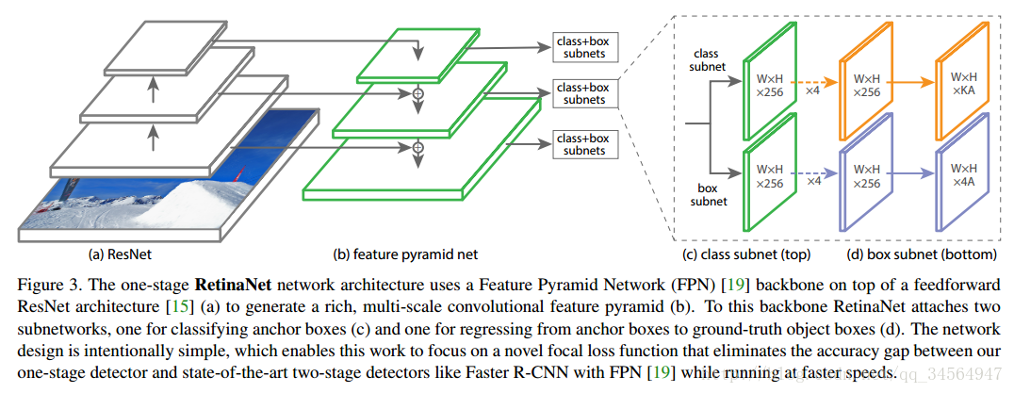
Model
RetinaNet = ResNet50+FPN + Decoupled sub-network + Focal loss
延时符

Slide 20
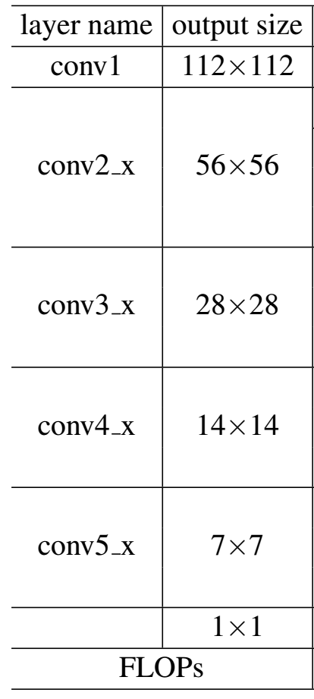
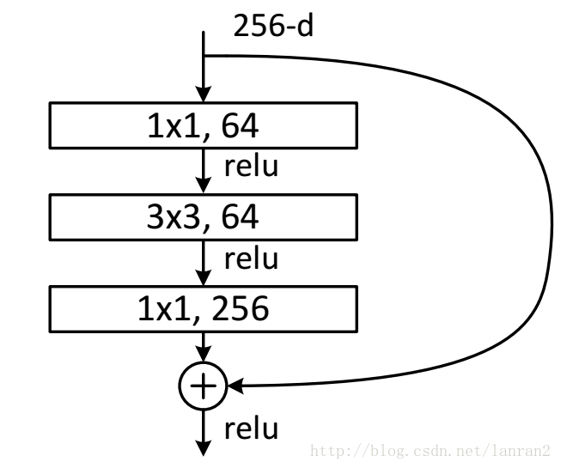
ResNet50
depth important -> gradient diffusion or gradient explosion
-> residual network
延时符
Notes:
退化问题，网络层数增加，但是在训练集上的准确率却饱和甚至下降了

Slide 21
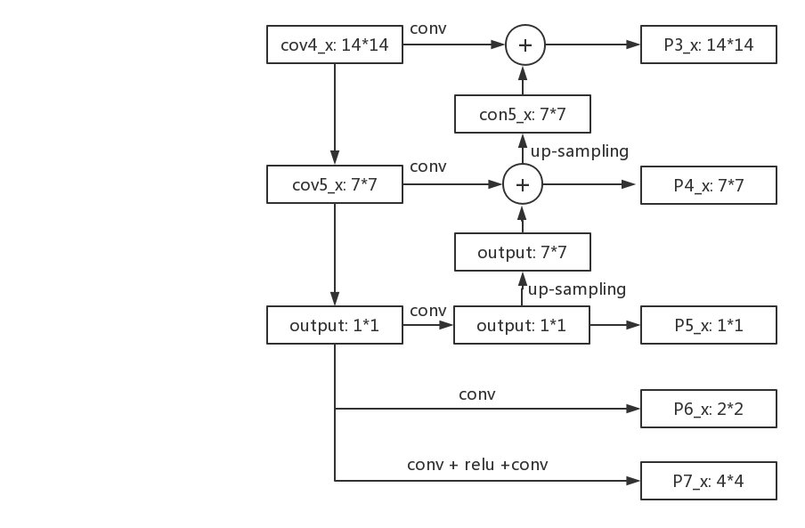
FPN
Low level:
semantic feature information : small
target position information : large
High level:
semantic feature information : large
target position information : small
Prediction in different layers
semantic feature information : large
target position information : large
延时符

Slide 22
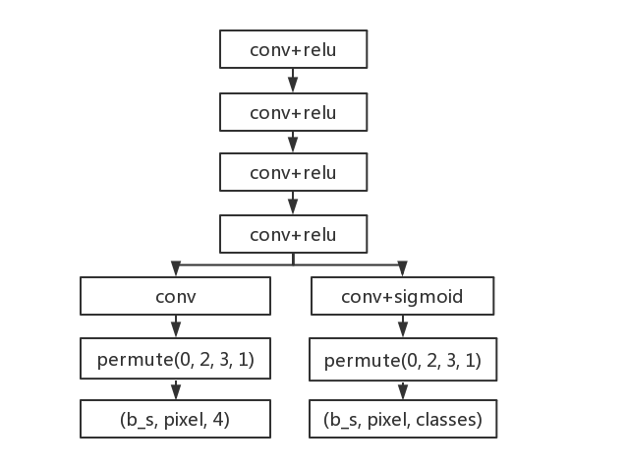
Cls & Reg
Each fpn output:
torch.cat()
anchor
Cls & Reg:
enjoy same structure
but doupled->different parameter
two focal loss->add->gross loss
延时符

Slide 23
Anchor机制 & loss
Anchor:
Generate anchor : ( ( 1*1+2*2+4*4+7*7+14*14)*9 ,4 )
Predict box : shift(anchor,predict) ( ( 1*1+2*2+4*4+7*7+14*14)*9 ,4)
Ground truth : annotations (num_truth,4)
Loss:
cls_loss : focal loss
reg_loss :smooth l1 loss
延时符

Slide 24
Focal loss
Cls_loss:
Focal loss only use in classification
Reg_loss:
Using smooth l1
Smooth at 0
Prevent gradient explosion
延时符
Notes:
退化问题，网络层数增加，但是在训练集上的准确率却饱和甚至下降了

Slide 25
Experiment
延时符

Slide 26
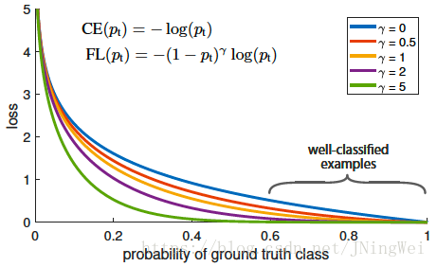
experiment
Article did an experiment on the value of γ.
延时符

Slide 27
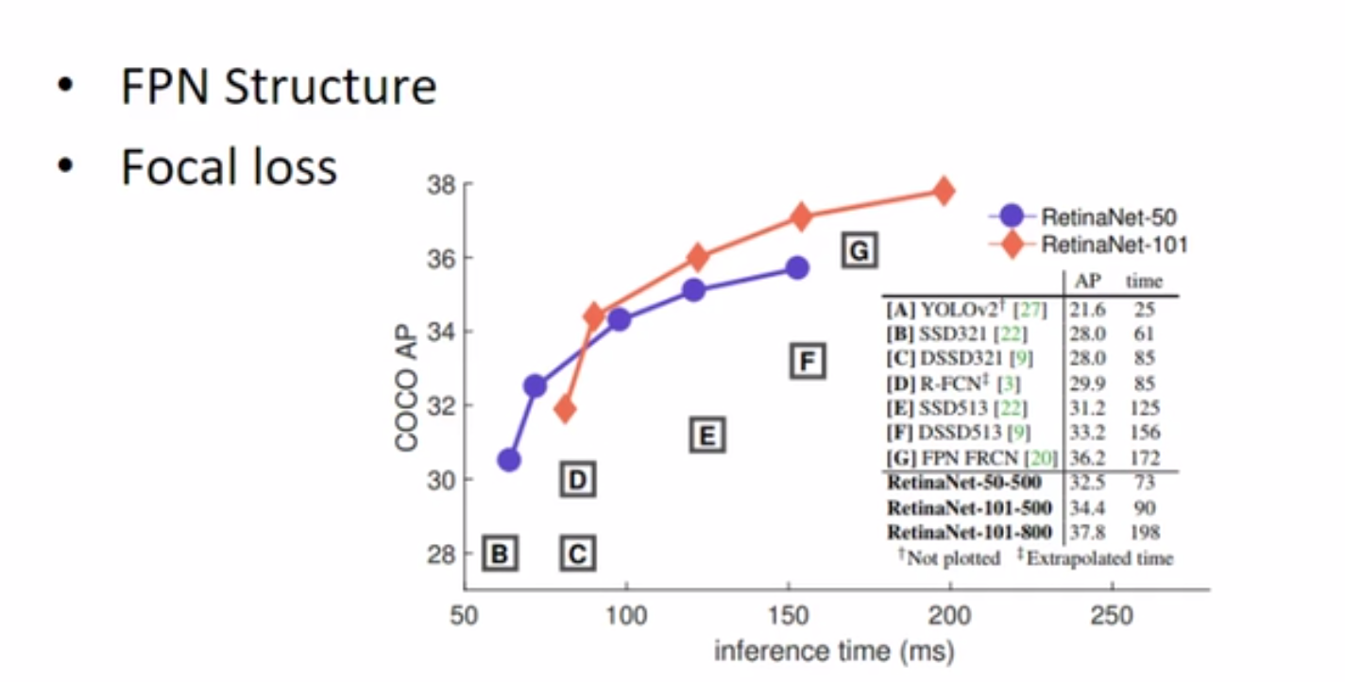
experiment
延时符

Slide 28
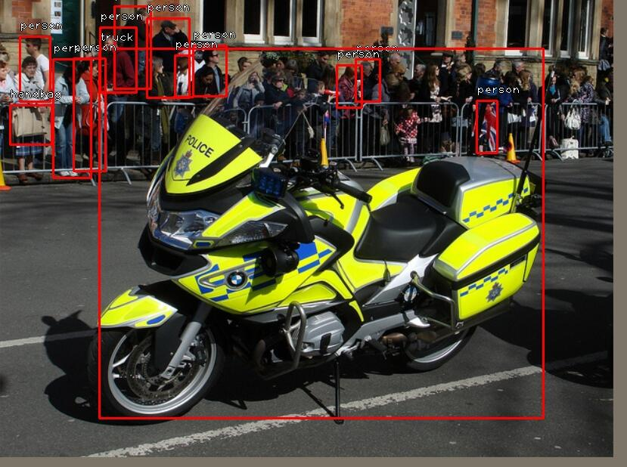
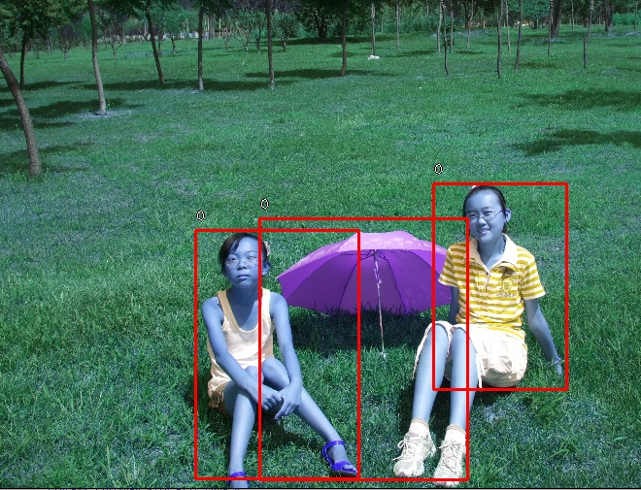
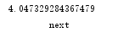
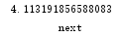
experiment
延时符

Slide 29
Summary
延时符

Slide 30
summary
Paper
This paper has deep insights and analysis of the root causes of category imbalances. Its first insight into the one-stage detector's low-caused problem is rooted in "category imbalance."
Model
RetinaNet is an FPN-based one-stage detector that relies on the final focal loss to resolve the category imbalance caused by excessive background.
延时符

Slide 31
THANK YOU FOR YOUR LISTENNING

